Slide 1
CAPSTONE PROJECT Internal vs external DNS RESOLUTION JANANI SRI 192511093 LOGESWARI 192565040 SARATH 192521169

Slide 2
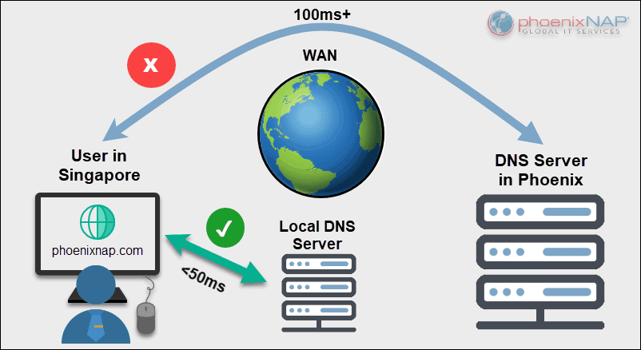
ABSTRACT
Introduction to DNS
Internal vs External DNS Resolution
Definition of response time and cache hits
IPS vs custom DNS
Tools and techniques used
Testing with nslookup
Result summary
Conclusion

Slide 3
.
WHAT IS DNS?
DNS, or the Domain Name System, is a hierarchical and distributed naming system that translates human-readable domain names (like google.com) into machine-readable IP addresses (like 172.217.160.142).
This allows users to access websites and other internet resources using easy-to-remember names instead of complex numerical IP addresses.

Slide 4
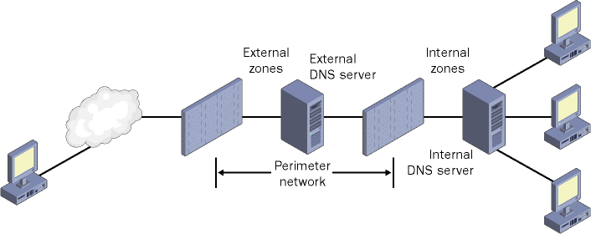
Internal vs external dns
Internal DNS and external DNS serve distinct purposes within a network.
Internal DNS resolves domain names to IP addresses for resources within a private network, like a company's internal servers and devices.
External DNS, on the other hand, handles domain name resolution for the public internet, translating domain names into public IP addresses so users worldwide can access websites and online services.

Slide 5

Response time and cache hits
Response time refers to the duration it takes for a system, device, or individual to react to a specific input or request.
It's a critical metric for evaluating performance and usability, especially in interactive systems like software applications, websites, and electronic devices.
In essence, it measures how quickly something responds to a command or action.

Slide 6

Cache hit
A cache hit occurs when requested data is found in the cache memory, allowing for faster retrieval than if the data had to be fetched from the main memory or a slower storage location.
Essentially, it means the cache is working effectively by providing the information quickly.

Slide 7

TOOLS AND TECHNIQUES USED
Q3
Q4
NSLOOKUP
Q1
WIRESHARK
Q2
PYTHON
BIND

Slide 8
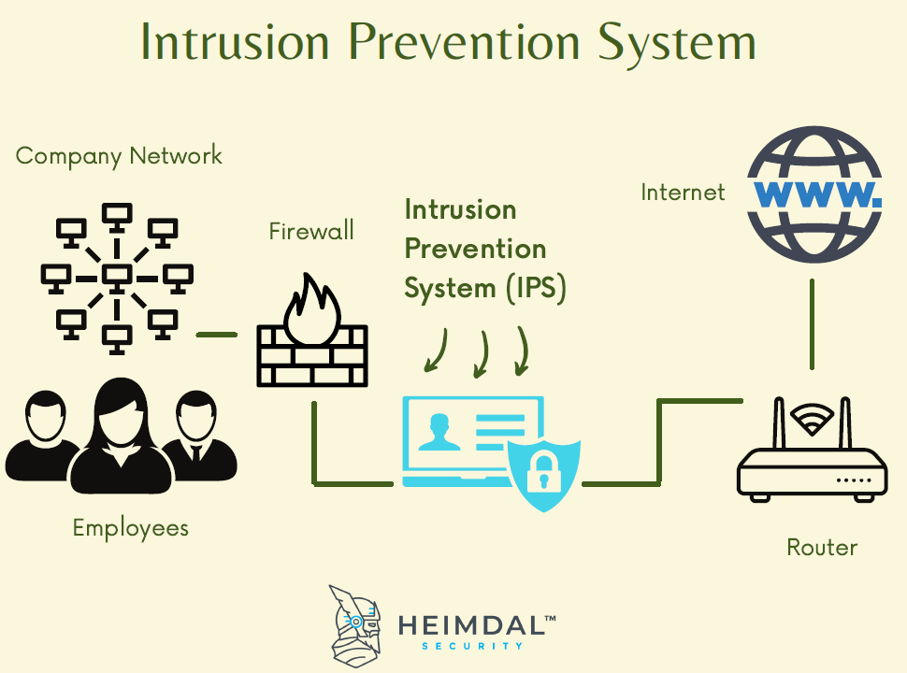
IPS VS CUSTOM DNS
IPS (Intrusion Prevention System) and custom DNS are distinct security measures with different roles.
IPS focuses on actively detecting and blocking malicious network traffic, while custom DNS offers benefits like faster browsing and potential privacy improvements by using a non-ISP DNS server.
IPS provides a proactive security layer, while custom DNS offers a more reactive approach.

Slide 9
TESTING IN NSLOOKUP
nslookup is a command-line tool used to query Domain Name System (DNS) servers to obtain domain name or IP address mapping, and other DNS record information.
It is a valuable tool for troubleshooting DNS resolution issues. You can use it to check if a domain name resolves to the correct IP address or to verify the existence of specific DNS records like MX or NS records.

Slide 10
A medium-sized IT company (e.g., TechCore Pvt. Ltd.) has an internal network used by 300 employees. The company hosts internal resources like: *File servers (\fileserver.local) *Development servers (dev.techcore.local) *Internal tools (jira.techcore.local, git.techcore.local) Employees’ devices use the internal DNS server (via DHCP).
REALTIME SCENARIO – INTERNAL DNS SETUP

Slide 11

WHY INTERNAL DNS? Prevents exposure of internal systems to the internet. Speeds up name resolution for LAN services. Helps in monitoring internal traffic and DNS logs.

Slide 12
The same company (TechCore Pvt. Ltd.) hosts a public website and mail services: www.techcore.com mail.techcore.com They want the world to access their services, hosted on a cloud provider like AWS or Digital Ocean. Goal:Make services accessible globally, manage DNS records like A, MX, CNAME
REALTIME SCENARIO – EXTERNAL DNS SETUP

Slide 13

WHY EXTERNAL DNS? Makes services accessible from anywhere. Provides high availability with global DNS networks. Can implement CDN, DdOS protection,and load balancing.

Slide 14
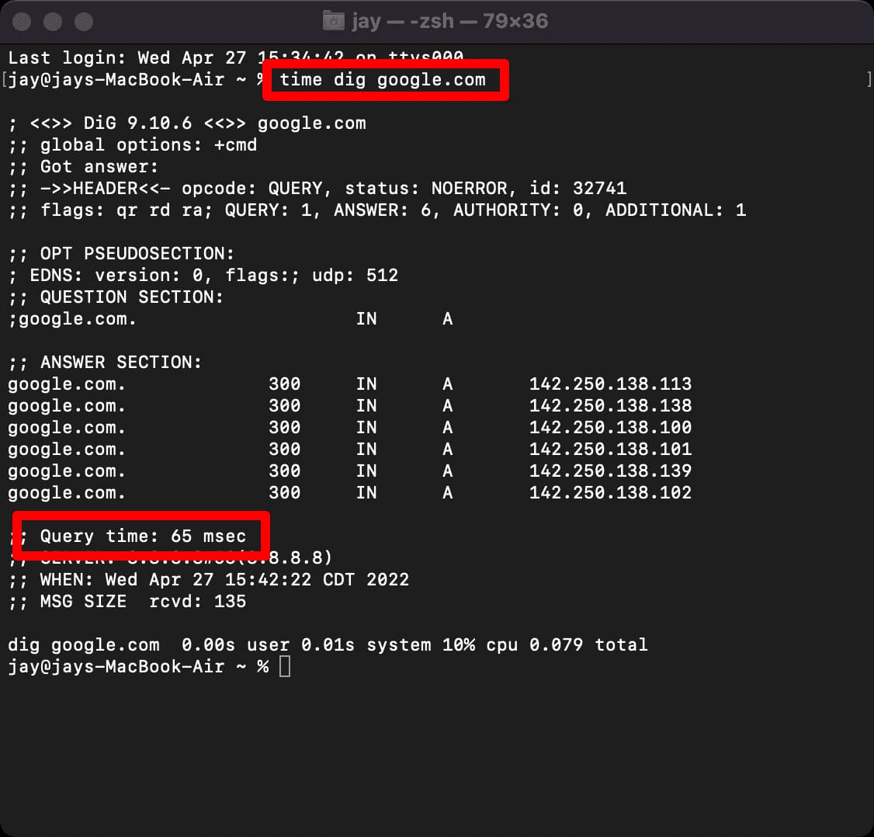

Slide 15
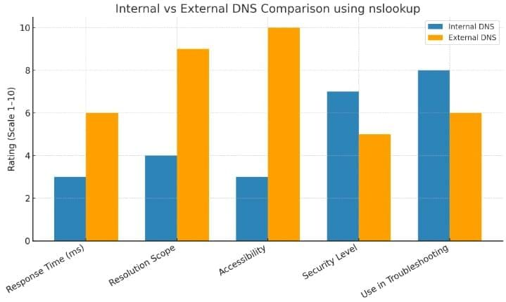
SAMPLE RESULTS
Internal DNS: Avg response = 18ms,
Cache hit = 70%.
Resolution Success Rate: 100%
External DNS: Avg response = 72ms,
Cache hit = 30%.
Resolution Success Rate : 95%
Internal DNS provides faster and more
reliable resolution whereas External DNS
provides very slow resolution.

Slide 16
Reflections on a DNS Server Project: Learning & Development
This presentation outlines the journey through a project focused on DNS server configuration and analysis. It reflects on key learning outcomes, challenges, and the practical application of engineering principles, culminating in insights relevant to industry practices and personal development.
Key Learning Outcomes
Developed skills in configuring a BIND DNS server.
Understood differences in DNS resolution times, caching, and TTL.
Gained experience with nslookup and Wireshark for DNS analysis.
Strengthened scripting/automation for testing and data collection.
Improved ability to present findings with graphs and structured documentation.

Slide 17
Navigating Project Obstacles
Every complex project presents its own set of hurdles. This section details the significant challenges encountered during the DNS server configuration and analysis, and critically, how these were systematically overcome through dedicated effort and problem-solving.
Configuration Complexities
Measuring Response Times
Initial difficulties arose with BIND zone file syntax and critical file permissions. This required meticulous review of documentation and iterative testing to achieve stable server operation.
Accurately measuring DNS response times proved challenging. This was overcome by developing custom scripts to automate timed queries and process large datasets effectively.
DNS Caching Inconsistencies
Network Troubleshooting
Inconsistent test results due to aggressive DNS caching were a significant hurdle. Resolution involved implementing cache flush tools and precise timing controls within the testing scripts.
Hands-on troubleshooting skills were honed by diagnosing issues spanning firewall rules, network connectivity, and intricate DNS configurations across different environments.

Slide 18

Conclusion: Advancing Technical & Professional Acumen
This project served as a pivotal experience, significantly enhancing both my technical proficiencies and broader professional skills. It provided a practical crucible for applying theoretical knowledge to real-world networking challenges.
Key Takeaways
Confidence Boost: Tackling complex networking issues has significantly increased my confidence
in problem-solving.
Project Lifecycle Mastery: From initial setup to final reporting, I gained hands-on experience
managing a full project lifecycle.
Enhanced Skillset: Persistent research, systematic troubleshooting, and effective scripting are
now firmly embedded skills.
Career Readiness: I feel better equipped for roles in networking, system administration, and
related technical fields.

Slide 19
Adhering to Engineering Excellence
The project was executed with a strong commitment to established engineering standards, ensuring robustness, reliability, and academic rigour. This approach underpinned every stage, from initial setup to final data analysis.
Security Best Practices
RFC Compliance
Applied industry best practices in DNS security, including stringent access control mechanisms and comprehensive logging for auditing and incident response.
Server setup and testing rigorously adhered to relevant DNS RFC protocols, ensuring a standards-compliant and interoperable solution.
Systematic Data Collection
Reproducibility & Version Control
Employed systematic testing methodologies to collect unbiased data, forming the foundation for accurate analysis and drawing valid conclusions.
Ensured full reproducibility of the project environment and results through meticulously documented procedures and strict version control for all configurations and scripts.

Slide 20
Industry Insights: The Evolving Landscape of DNS
Beyond the technical implementation, this project offered valuable insights into the broader implications of DNS within modern industry, highlighting critical considerations for network architects and service providers.
Performance is Paramount
Internal vs. External DNS
Demonstrated that DNS performance is a critical factor directly impacting user experience, particularly in high-availability and latency-sensitive network environments.
Underlined how large enterprises strategically leverage both internal and external DNS infrastructure for redundancy, load balancing, and performance tuning.
ISP Influence on DNS
Privacy-Focused Protocols
Revealed how Internet Service Providers (ISPs) can filter or shape DNS traffic, potentially affecting reliability and access to certain resources for end-users.
Acknowledged the growing industry trend towards the adoption of privacy-enhancing DNS protocols, such as DNS over HTTPS (DoH), to encrypt queries and improve user privacy.

Slide 21
QUERY DOMAIN
In Computer Networks and DNS (Domain Name System), a Query Domain refers to the domain name for which a DNS client (like a web
browser) wants to find the IP address

Slide 22
TYPES OF DNS QUERIES
1.Recursive Query - DNS server does all the work to resolve the query domain.
2.Iterative Query - DNS server refers the client to another server.
3. Inverse Query - Used to find domain name from an IP (reverse lookup)

Slide 23
EXAMPLE
Suppose you want to access www.mit.edu
·
DNS Query sent –
Query Domain = www.mit.edu
The DNS server will return - Response: 18.9.22.69 (IP Address of www.mit.edu)

Slide 24
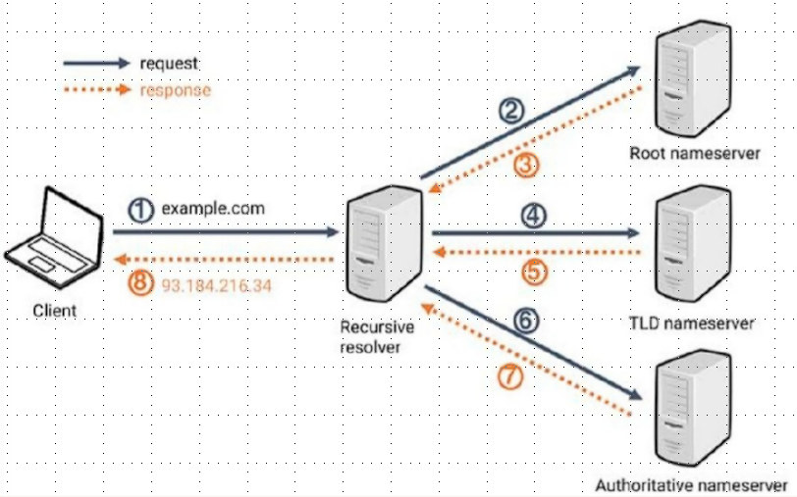
Domain queries

Slide 25
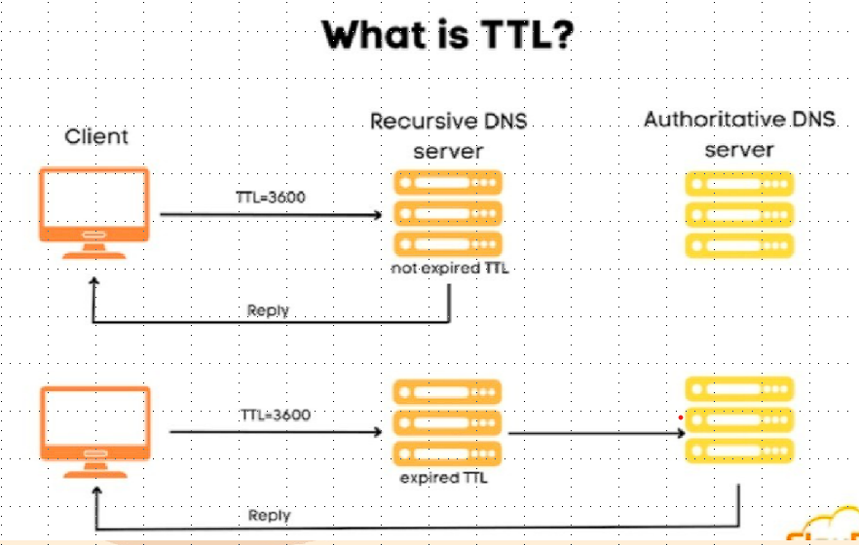

Slide 26
Ttl value
TTL (Time To Live) is a value used in networking to specify how long data should be kept alive or how far it should travel before being discarded.
TTL is a field in the IP packet header that limits the lifetime or number of hops a packet can take through a network.
It helps prevent packets from circulating indefinitely in case of routing loops.

Slide 27
example
If a packet has TTL =5, and it passes through 5routers
After1st router: TTL =4
After 2nd router: TTL =3
After 5th router: TTL =0- The packet is dropped.

Slide 28
concluSion
Internal DNS is faster for repeated lookups due to caching
External DNS is easier to use, but offers less control
Best option: Internal DNS with forwarding to Google DNS

Slide 29
Thank you

